Slide 1



Slide 2
Data Structure

Slide 3
Introduction DSA

Slide 4
Introduction:- DSA
The term Data Structure refers to the storage and organization of data, and Algorithm refers to the step by step procedure to solve a problem. By combining "data structure" and "algorithm", we optimize the codes in software engineering.
In computer science, a data structure is a data organization, management, and storage format that enables efficient access and modification. More precisely, a data structure is a collection of data values, the relationships among them, and the functions or operations that can be applied to the data.
A data structure is a named location that can be used to store and organize data. And, an algorithm is a collection of steps to solve a particular problem. Learning data structures and algorithms allow us to write efficient and optimized computer programs.

Slide 5
Data Structure Classification
Built-in Data Structure. Examples: Integer, Float etc.
User Define Data Structure. Examples: List, Dict, Stack, Link-list, Queue etc.

Slide 6
Table
Characteristic | Description
Linear | In Linear data structures, the data items are arranged in a linear sequence. Example: List
Non-Linear | In Non-Linear data structures, the data items are not in sequence. Example: Tree, Graph
Homogeneous | In homogeneous data structures, all the elements are of same type. Example: Integer, Float, String
Non-Homogeneous | In Non-Homogeneous data structure, the elements may or may not be of the same type. Example: List, Link-list, Dict, tree etc.

Slide 7
Bad programmers worry about the code. Good programmers worry about data structures and their relationships.” - Linus Torvalds

Slide 8
Algorithms
An algorithm is a finite set of instructions or logic, written in order, to accomplish a certain predefined task. Algorithm is not the complete code or program, it is just the core logic(solution) of a problem, which can be expressed either as an informal high level description as pseudocode or using a flowchart.
Algorithm refers to the step by step procedure to solve a problem.

Slide 9
Algorithm satisfy the following
Input:- There should be 0 or more inputs supplied externally to the algorithm.
Output:- There should be at least 1 output obtained.
Definiteness:- Every step of the algorithm should be clear and well defined.
Finiteness:- The algorithm should have finite number of steps.
Correctness:- Every step of the algorithm must generate a correct output.

Slide 10
largest number among three different numbers
Step 1: Start
Step 2: Declare variables a, b and c.
Step 3: Read variables a, b and c.
Step 4: If a > b
If a > c
Display a is the largest number.
Else
Display c is the largest number.
Else
If b > c
Display b is the largest number.
Else
Display c is the greatest number.
Step 5: Stop

Slide 11
Factorial of a number entered by the user
Step 1: Start
Step 2: Declare variables n, factorial and i.
Step 3: Initialize variables
factorial ← 1
i ← 1
Step 4: Read value of n
Step 5: Repeat the steps until i = n
5.1: factorial ← factorial*i
5.2: i ← i+1
Step 6: Display factorial
Step 7: Stop

Slide 12
Space Complexity
Space complexity is the total amount of memory space used by an algorithm/program including the space of input values for execution. So to find space-complexity, it is enough to calculate the space occupied by the variables used in an algorithm/program.
Its the amount of memory space required by the algorithm, during the course of its execution. Space complexity must be taken seriously for multi-user systems and in situations where limited memory is available.
Important Note: The best algorithm/program should have the lease space-complexity. The lesser the space used, the faster it executes.

Slide 13
Space Complexity
Instruction Space: Its the space required to store the executable version of the program. This space is fixed, but varies depending upon the number of lines of code in the program.
Data Space: Its the space required to store all the constants and variables(including temporary variables) value.
Environment Space: Its the space required to store the environment information needed to resume the suspended function.

Slide 14
Time Complexity
Time Complexity is a way to represent the amount of time required by the program to run till its completion
The algorithm that performs the task in the smallest number of operations is considered the most efficient one in terms of the time complexity.

Slide 15
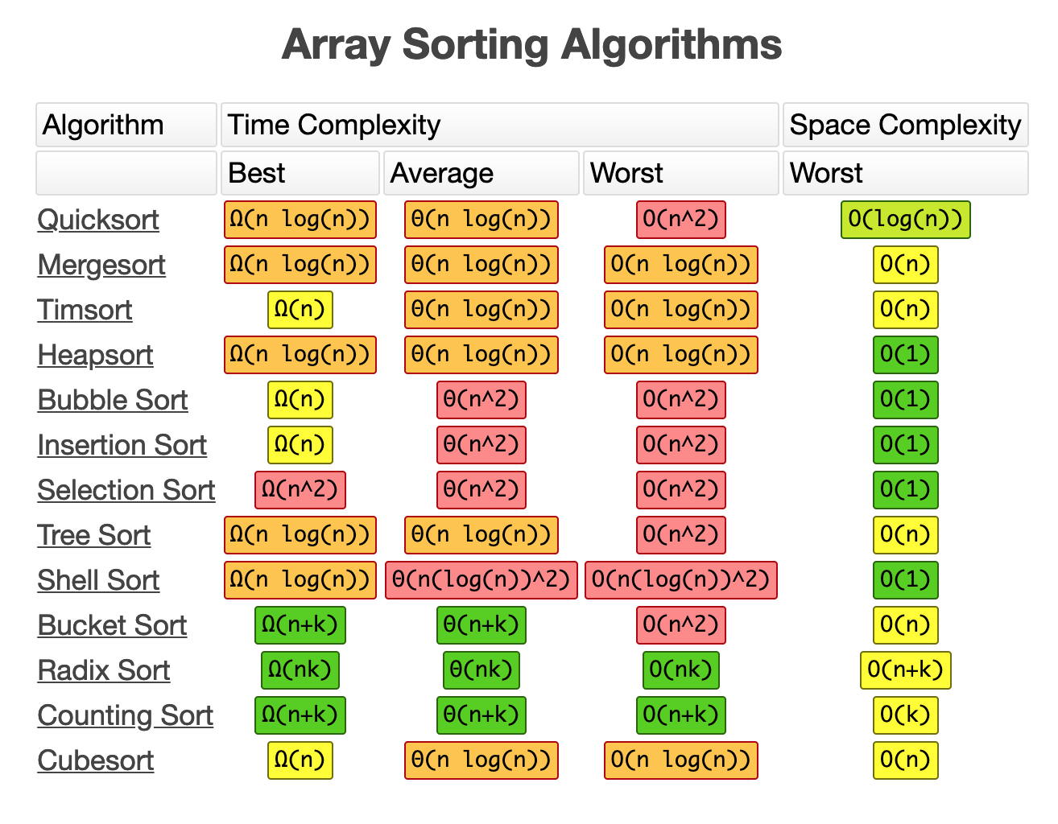
Algorithms Space and Time Complexity

Slide 16
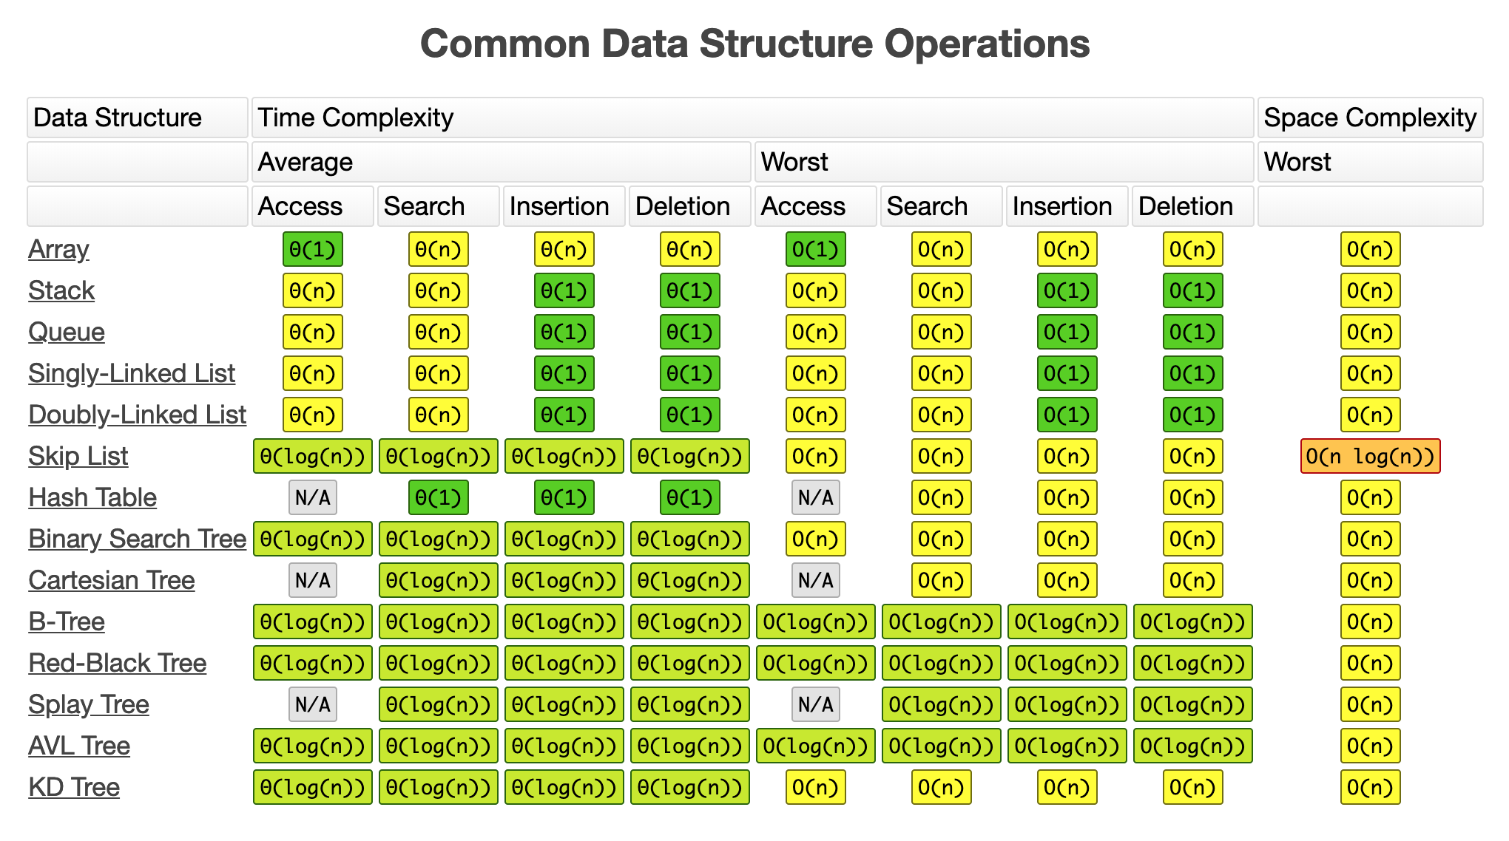
DS Space and Time Complexity

Slide 17
usage
Facebook (Yes… we are talking about your favorite application). Can you just imagine that your friends on Facebook, friends of friends, mutual friends they all can be represented easily by Graph? Relax….sit for a couple of moments and think again…you can apply graph to represent friends connection on Facebook.
If you need to keep a deck of cards and arrange it properly how would you do that? You will throw it randomly or you will arrange the cards one over another and from a proper deck. You can use Stack here to make a proper arrangement of cards one over another.
If you need to search a word in the dictionary, what would be your approach? Do you go page by page or you open some page and if the word is not found you open a page prior/later to one opened depending upon the order of word to the current page (Binary Search).

Slide 18
Not to mention, a programmer should know how to use an appropriate data structure in the right algorithm. There is a famous saying: “A warrior should not just possess a weapon, he must know when and how to use it.” -unknown

Slide 19
Link-List
Subtitle

Slide 20
Contents Link-List
Introduction Link-list
Space Complexity
Time Complexity
Examples
Usage
Link-list Types

Slide 21
Link-List
A linked list data structure includes a series of connected nodes. Here, each node store the data and the address of the next node.
You have to start somewhere, so we give the address of the first node a special name called HEAD
Also, the last node in the linked list can be identified because its next portion points to NULL

Slide 22

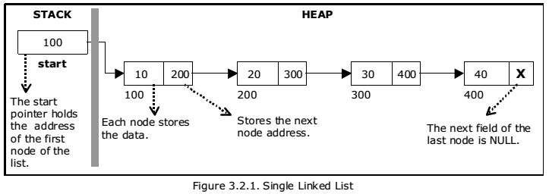
Link-list Representation and Example

Slide 23
Link-list Types
There are three common types of Linked List.
Singly Linked List
Doubly Linked List
Circular Linked List

Slide 24
Singly Linked List
It is the most common. Each node has data and a pointer to the next node.
It is the simplest type of linked list in which every node contains some data and a pointer to the next node of the same data type. The node contains a pointer to the next node means that the node stores the address of the next node in the sequence

Slide 25

Doubly Linked List
We add a pointer to the previous node in a doubly-linked list. Thus, we can go in either direction: forward or backward.
A doubly linked list or a two-way linked list is a more complex type of linked list which contains a pointer to the next as well as the previous node in sequence, Therefore, it contains three parts are data, a pointer to the next node, and a pointer to the previous node

Slide 26
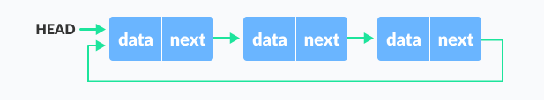
Circular Linked List
A circular linked list is a variation of a linked list in which the last element is linked to the first element. This forms a circular loop.
A circular linked list is that in which the last node contains the pointer to the first node of the list. While traversing a circular liked list, we can begin at any node and traverse the list in any direction forward and backward until we reach the same node we started.

Slide 27
Usage
Due to their dynamic size allocation and ease of insertion/deletion, linked lists are applied in a lot of use cases.
They’re used to implement a lot of complex data structures like the adjacency list in graphs.
They are used for lifecycle management in operating systems.
A playlist in a music application is implemented using a doubly linked list.
A good analogy to linked lists would be a simple webpage, that contains all the search results for cats, we won’t be able to list all the results in one page, so we are giving one page full of results and a “Next” button to go to the next page, the head. We will be hitting that “Next” button until that button no longer is displayed, meaning that we are at the end of the list, its tail.

Slide 28
Stack
Subtitle

Slide 29
Introduction Stack
A stack is a linear data structure that stores items in a Last-In/First-Out (LIFO) or First-In/Last-Out (FILO) manner. In stack, a new element is added at one end and an element is removed from that end only. The insert and delete operations are often called push and pop.
Stack is a LIFO(Last in First out) structure or we can say FILO(First in Last out).

Slide 30
The functions associated with Stack
empty():– Returns whether the stack is empty.
size():– Returns the size of the stack.
top():– Returns a reference to the top most element of the stack.
push(g):– Adds the element ‘g’ at the top of the stack.
pop():– Deletes the top most element of the stack.

Slide 31
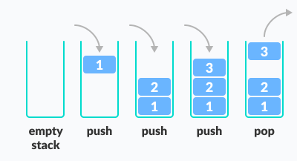
Example

Slide 32
Working of Stack.
?

Slide 33
Queue
Subtitle

Slide 34
Queue
Like stack, queue is a linear data structure that stores items in First In First Out (FIFO) manner. With a queue the least recently added item is removed first. A good example of queue is any queue of consumers for a resource where the consumer that came first is served first.
Queue is also an abstract data type or a linear data structure, just like stack data structure, in which the first element is inserted from one end called the REAR(also called tail), and the removal of existing element takes place from the other end called as FRONT(also called head).

Slide 35
The functions associated with Queue are:
Enqueue: Adds an item to the queue. If the queue is full, then it is said to be an Overflow condition
Dequeue: Removes an item from the queue. The items are popped in the same order in which they are pushed. If the queue is empty, then it is said to be an Underflow condition
Front: Get the front item from queue
Rear: Get the last item from queue

Slide 36
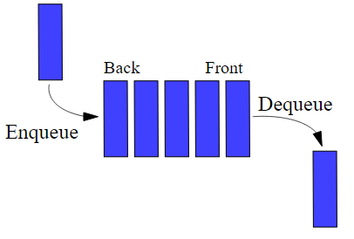
Example:

Slide 37
Working of Queue.
?

Slide 38
Tree
Subtitle

Slide 39
Contents Tree
Introduction Tree
Tree Traversal
Usage
Tree Types
Tree Terminologies

Slide 40
Tree Data Structure
A tree is a nonlinear hierarchical data structure that consists of nodes connected by edges.
Tree data structures allow quicker and easier access to the data as it is a non-linear data structure.

Slide 41
Tree Terminologies
Node: A node is an entity that contains a key or value and pointers to its child nodes.
The last nodes of each path are called leaf nodes or external nodes that do not contain a link/pointer to child nodes.
The node having at least a child node is called an internal node.
Edge: It is the link between any two nodes.
Root: It is the topmost node of a tree.
Height of a Node: The height of a node is the number of edges from the node to the deepest leaf (i.e. the longest path from the node to a leaf node).

Slide 42
Tree Terminologies
Depth of a Node: The depth of a node is the number of edges from the root to the node.
Height of a Tree: The height of a Tree is the height of the root node or the depth of the deepest node.
Degree of a Node: The degree of a node is the total number of branches of that node.

Slide 43
Types of Tree
Binary Tree
Binary Search Tree
AVL Tree

Slide 44
Binary Tree
A binary tree is a tree data structure in which each parent node can have at most two children.
A binary tree is a hierarchical data structure in which each node has at most two children generally referred as left child and right child.

Slide 45
Binary Search Tree(BST)
Binary search tree is a data structure that quickly allows us to maintain a sorted list of numbers.
It is called a binary tree because each tree node has a maximum of two children.
It is called a search tree because it can be used to search for the presence of a number in O(log(n)) time.
The properties that separate a binary search tree from a regular binary tree is:
All nodes of left subtree are less than the root node
All nodes of right subtree are more than the root node

Slide 46
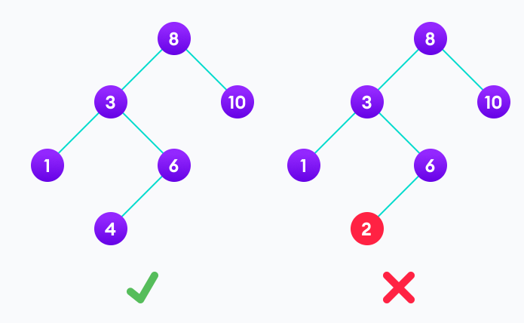
Example of Binary Search Tree(BST)

Slide 47
AVL Tree
AVL tree is a self-balancing binary search tree in which each node maintains extra information called a balance factor whose value is either -1, 0 or +1.
AVL tree got its name after its inventor Georgy Adelson-Velsky and Landis.

Slide 48
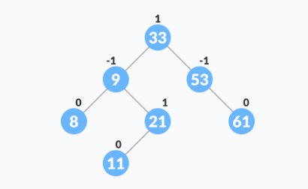
Balance Factor
Balance factor of a node in an AVL tree is the difference between the height of the left subtree and that of the right subtree of that node.
Balance Factor = (Height of Left Subtree - Height of Right Subtree) or (Height of Right Subtree - Height of Left Subtree)
The self balancing property of an AVL tree is maintained by the balance factor. The value of balance factor should always be -1, 0 or +1.

Slide 49
Tree Traversal
Traversing a tree means visiting every node in the tree
Type of Tree Traversal:
Inorder Tree Traversal.
Preorder Tree Traversal.
Postorder Tree Traversal.

Slide 50
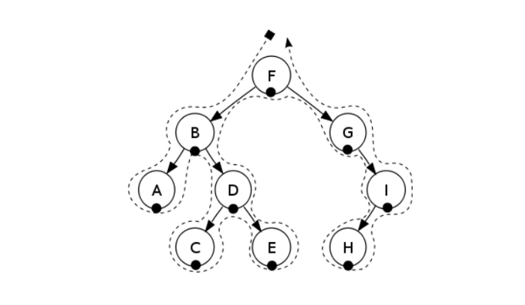
Inorder Tree Traversal
First, visit all the nodes in the left subtree
Then the root node
Visit all the nodes in the right subtree

Slide 51
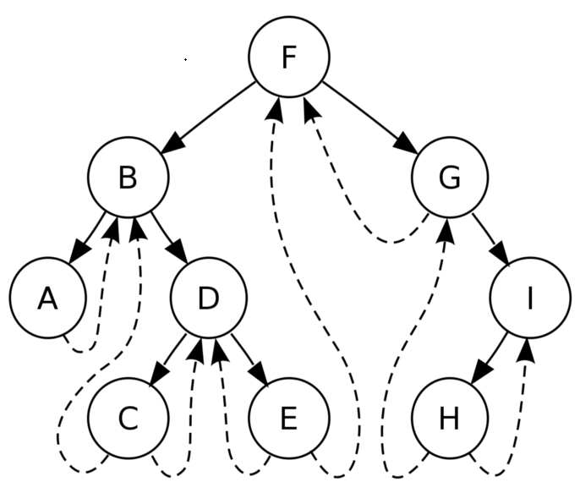
Preorder Tree Traversal
Visit root node
Visit all the nodes in the left subtree
Visit all the nodes in the right subtree

Slide 52
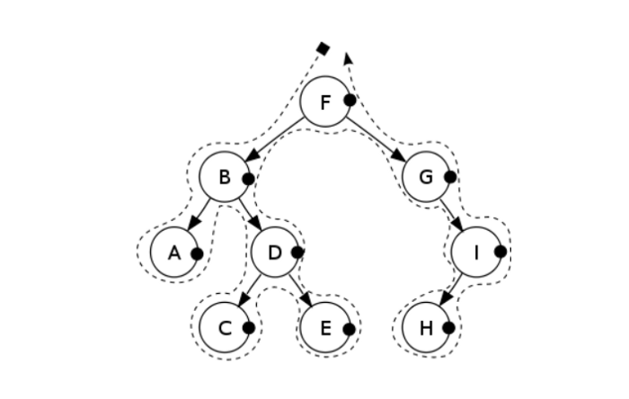
Postorder Tree Traversal
Visit all the nodes in the left subtree
Visit all the nodes in the right subtree
Visit the root node

Slide 53
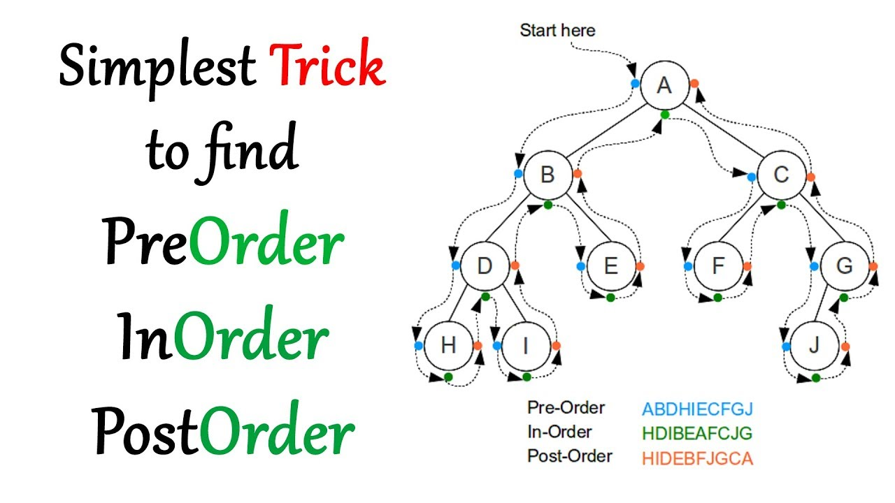
Example:

Slide 54
Usage:
Store hierarchical data, like folder structure, organization structure, XML/HTML data.
Binary Search Tree is a tree that allows fast search, insert, delete on a sorted data. It also allows finding closest item
One reason to use trees might be because you want to store information that naturally forms a hierarchy. For example, the file system on a computer

Slide 55
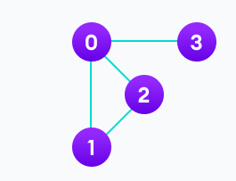
Graph
Graphs are complex, non-linear data structures that are characterized by a group of vertices, connected by edges.
A graph data structure is a collection of nodes that have data and are connected to other nodes.

Slide 56
Graph Terminologies
Vertex: Vertices are entities in a graph. Every vertex has a value associated with it. For example, if we represent a list of cities using a graph, the vertices would represent the cities.
Edge: Edges represent the relationship between the vertices in the graph. Edges may or may not have a value associated with them. For example, if we represent a list of cities using a graph, the edges would represent the path between the cities.
Weight: Edges may be weighted to show that there is a cost to go from one vertex to another.
Unweighted: An unweighted graph does not have a value associated with every edge.
Directed: In a directed graph or digraph, the edges have an orientation.
Undirected: In an undirected graph, the edges have no path or direction.

Slide 57
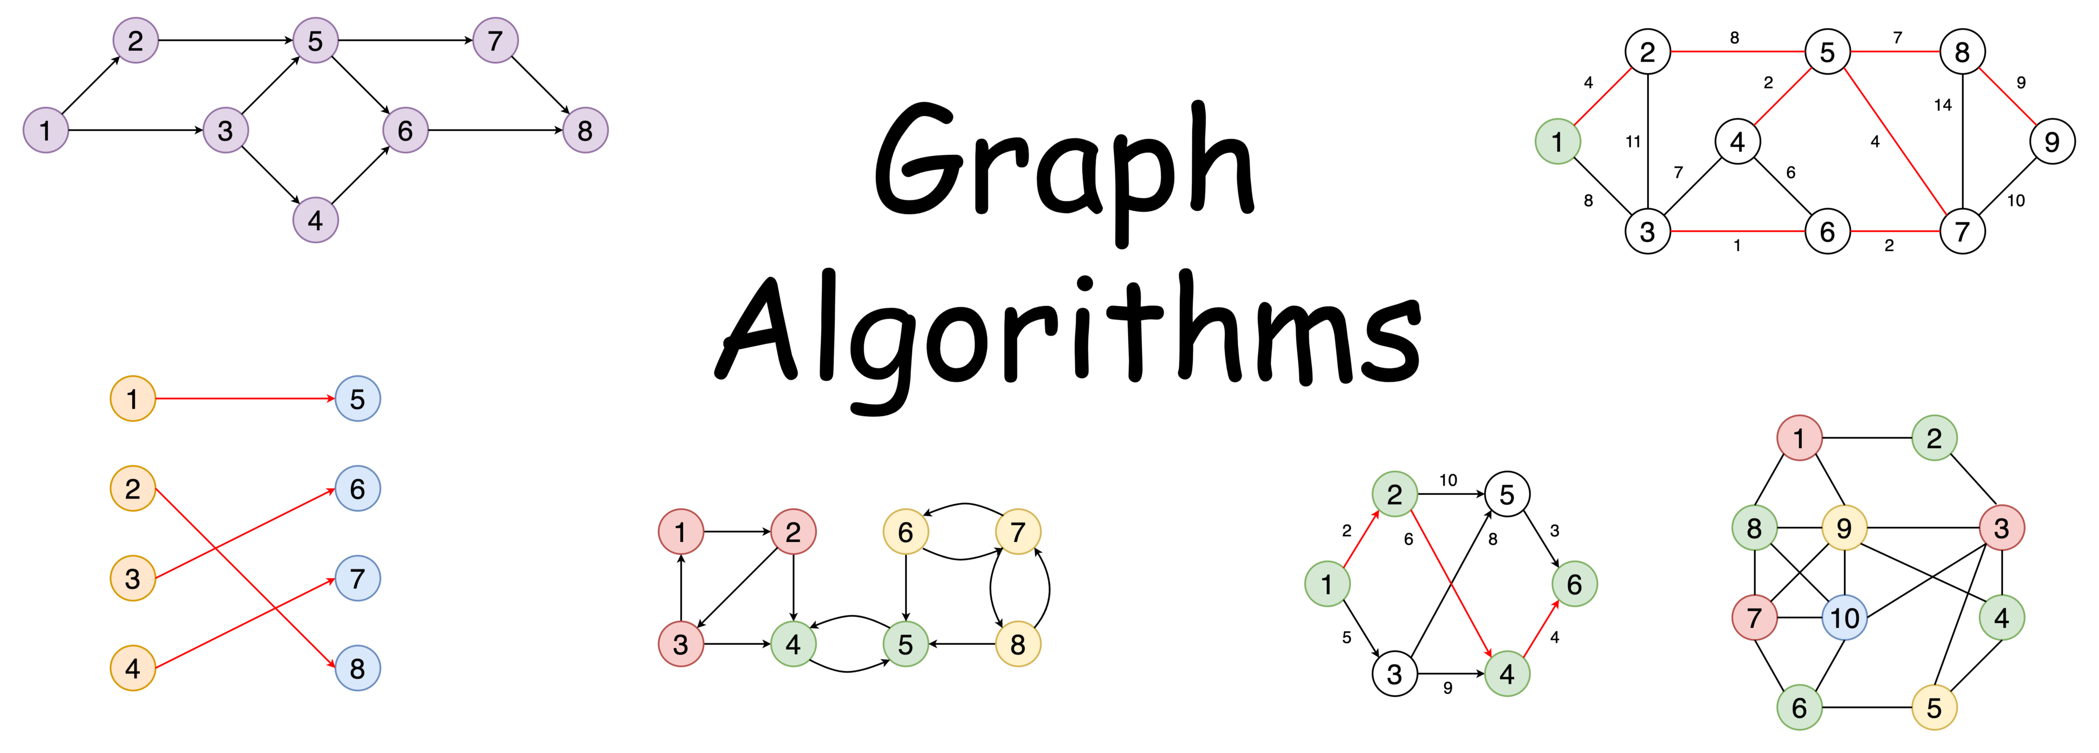
Example:

Slide 58
Application of Graphs:
In computer science, graphs are used to represent networks of communication, data organization, computational devices.
Graph theory is also used to study molecules in chemistry and physics.
In mathematics, graphs are useful in geometry.
Weighted graphs, are used to represent structures in which pairwise connections have some numerical values. Ex: Road Network.
Graph algorithms are useful for calculating the shortest path in Routing .
Maps – finding the shortest/cheapest path for a car from one city to another, by using given roads.

Slide 59
Contact
Email:- abdjabbar110@gmail.com
LinkedIn:- https://www.linkedin.com/in/abdul-jabbar-7b1401132/
FB Profile:- https://www.facebook.com/profile.php?id=100008792711291
GitHub:- https://github.com/AbdulJabbar64
Contact No:- +923123712792

Slide 60
Thank You

